Slide 1
Capstone Project-4
Book Recommendation System
Team Members i) Saurabh Yadav ii) Shubham Deshmukh

Slide 2

Content
Problem Statement
Data Summary
Analysis of Data
Null value Imputation/ Data Cleaning
Data Preprocessing
Model Training
Evaluation Metrics
Challenges
Conclusion

Slide 3

Problem Statement:
Recommender systems are really critical in some industries as they can generate a huge amount of income when they are efficient or also be a way to stand out significantly from competitors.
The objective of the project is to build a book recommendation system for users based on popularity and user interests.

Slide 4

Data Summary: The Book-Crossing dataset comprises 3 files which Contains 278,858 users (anonymised but with demographic information) providing 1,149,780 ratings about 271,360 books.
Users_dataset.
User-ID (unique for each user)
Location (contains city, state and country separated by commas)
Age Shape of Dataset - (278858, 3)
Books_dataset.
ISBN (unique for each book)
Book-Title
Book-Author
Year-Of-Publication
Publisher
Image-URL-S
Image-URL-M
Image-URL-L
Shape of Dataset - (271360, 8)
Ratings_dataset.
User-ID
ISBN
Book-Rating
Shape of Dataset - (1149780, 3)

Slide 5
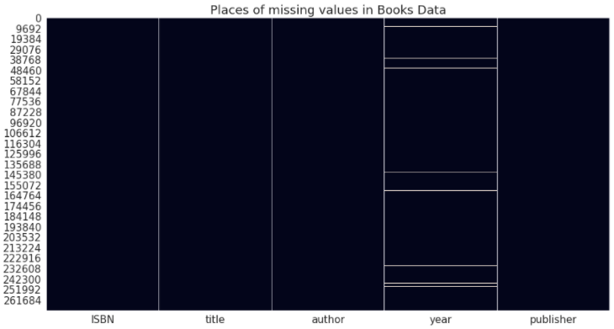
Where are the missing values?
The book dataset ‘year’ column have 4690 missing values.

Slide 6
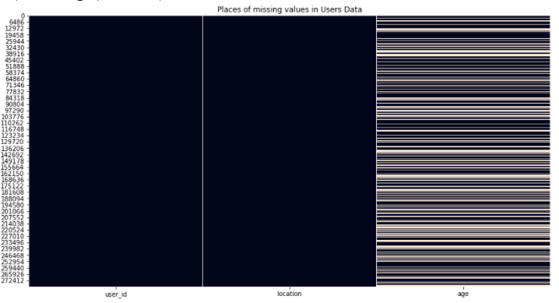
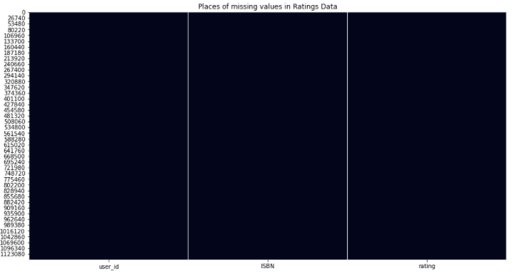
Contd..
The users dataset ‘Age’ column have missing values.
The ratings dataset don’t have missing values.

Slide 7

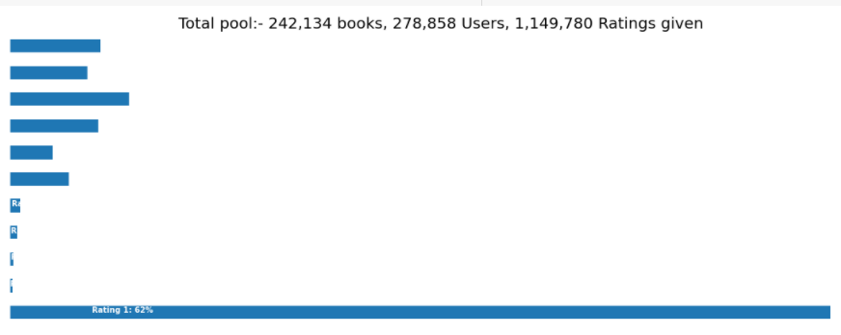
Visualizing the data
Here we can see that we have data
1)Number of books - 242134
2)Number of users -278858
3)Total Number of Ratings- 1149780

Slide 8
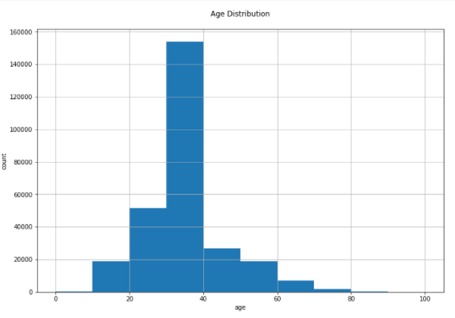
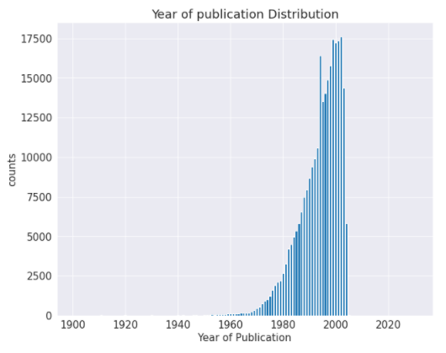
Distribution of ‘age’ and ‘year of publication’ variable
Most active readers lie in age group 20- 40. Publication years are somewhat between 1950 - 2005 here.

Slide 9
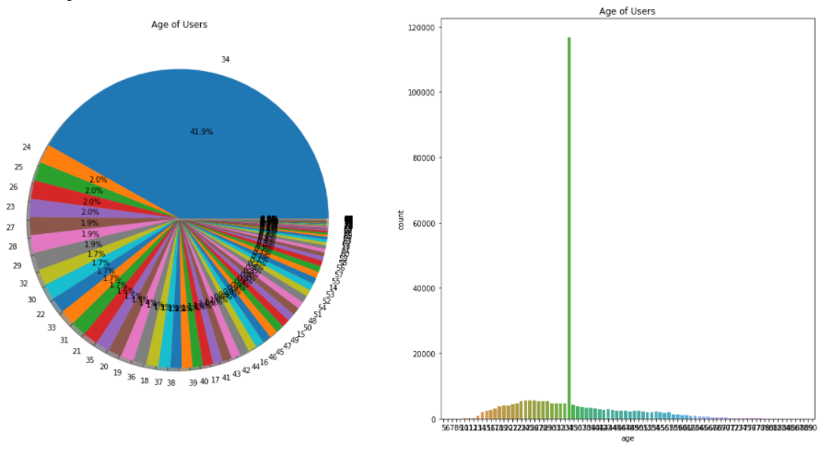
Contd..
We observed that 41.9% of age 34 group read more books compared to other age groups.
Also the users with the age 60 and above do not read more books.

Slide 10
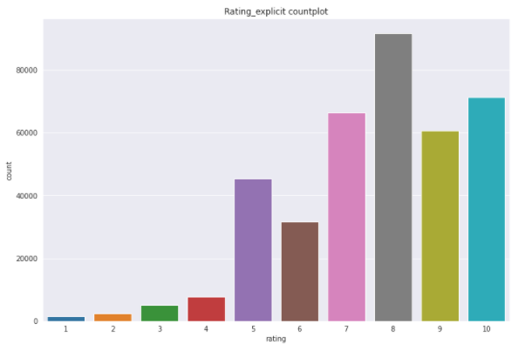
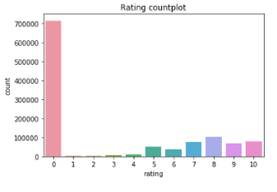
Analysis of Rating feature
First plot shows users have rated 0 the most, which can mean they haven't rated books at all.
On second plot we have separated the explicit ratings represented by 1–10.

Slide 11
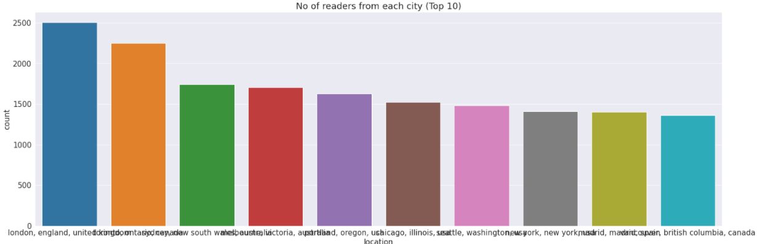
Exploring Locations of top Users:
Here we can observe that user with locations London, england, united kingdom,
Toronto, ontario, canda are high in numbers.

Slide 12
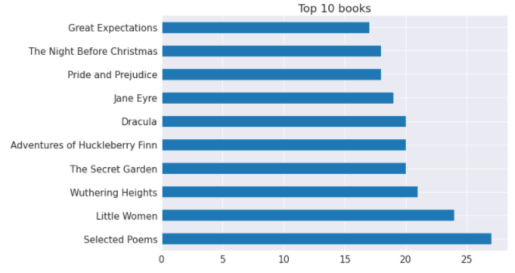
Exploring Top 10 Books:
Bar plot shows us popular books.From above plot we can see that selected poems is highest in number.

Slide 13
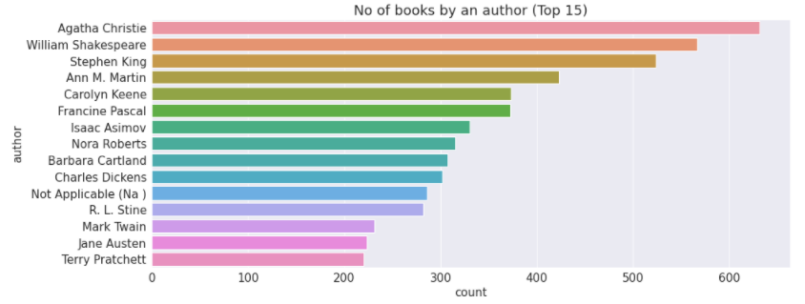
Exploring Top Authors:
Agatha Christie wrote highest number of books in our given dataset.

Slide 14

Data Preprocessing:
First, we’ve renamed the columns of each file. Because the name of the column contains space, and uppercase letters so we will correct as to make it easy to use.
Book Dataset:
In the books dataset, we have some extra columns which are not required for our task like ‘Image-URL-S’, ‘Image-URL-M’ and ‘Image-URL-L’ so we exclude that column.
In ‘year’ column it looks like ‘publisher’ names 'DK Publishing Inc' and 'Gallimard' have been incorrectly loaded as year in dataset due to some errors in csv file. Also some of the entries are strings and same years have been entered as numbers in some places.

Slide 15
Contd..
Users dataset:
In users data ‘age’ column has some invalid entries like nan, 0 and very high values like 100 and above. In our view values below 5 and above 90 do not make much sense for our book rating case...hence replacing these by NaNs.
Then we replaced NaNs with mean of age.
Ratings Dataset:
We‘ve only taken the ISBNs that also belongs to the main books set(as unique_rating).
Also we’ve taken the rating from users which exist in users dataset, unless new users or book are added to users dataset.
We have separated the explicit ratings represented by 1–10 and implicit ratings represented by 0. Because users who have rated 0 the most, which can mean they haven't rated books at all.
ratings dataset | unique_ratings dataset | explicit_ratings dataset
11,49,780 rows | 10,31,135 rows | 3,83,841 rows

Slide 16
Contd..
For Popularity based recommendation system we only consider ISBNs that were explicitely rated than we merge ratings_explicit dataset with books dataset on ISBNs features. After that we grouped the data based on ‘title’ and aggregate based on ‘rating’.
For Collaborative Filtering using kNN(k-Nearest Neighbors) to ensure statistical significance, users who has given less than 200 ratings, and books with less than 100 ratings are excluded.
The dataset ‘ratings' and ‘books' have common column 'ISBN‘, so we create new data-frame by merging the two data-frames on ISBN (as book_with_rating) than we group by book titles and create a new column for total rating count and store in new data-frame rating_count_df also done the renaming on rating column as total_ratings.

Slide 17
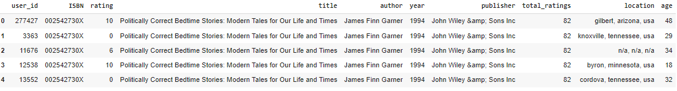
Contd..
Now we will combine the books_with_rating with the rating_count_df data, this gives us exactly what we need to find out which books are popular and filter out lesser-known books.
Then we’ve considered only books having minimum total 50 ratings(Threshold) by creating new data-frame as rating_popular_book after that we’ve merged the 'users' dataframe with 'rating_popular_book' dataframe and stored them into ‘combined’ data-frame.
Also we’ve dropped the duplicate values from ‘combined’ data-frame.

Slide 18
Contd..
For SVD(Singular Value Decomposition) Based recommendation System we’ve used Surprise (it is a Python sci-kit for building and analyzing recommender systems that deal with explicit rating data.)
The name Surprise (roughly) stands for Simple Python Recommendation System Engine.
From surprise we imported ‘Reader’ to set the limit of rating (in our case 1 to 10) & ‘Dataset’ to load ratings_explicit data.

Slide 19
Model building, Predictions:
Here we’ve build 3 models for Book Recommendation :
Popularity Based Recommendation(Base Model): These model check about the product or movie which are in trend or are most popular among the users and directly recommend those.
Collaborative Filtering Using KNN ( k-Nearest Neighbors): kNN is a machine learning algorithm to find clusters of similar users based on common book ratings, and make predictions using the average rating of top-k nearest neighbors.
SVD(Singular Value Decomposition) Based recommendation System: The SVD(Singular Value Decomposition) is used as a collaborative filtering technique. It uses a matrix structure where each row represents a user, and each column represents an item. The elements of this matrix are the ratings that are given to items by users.

Slide 20
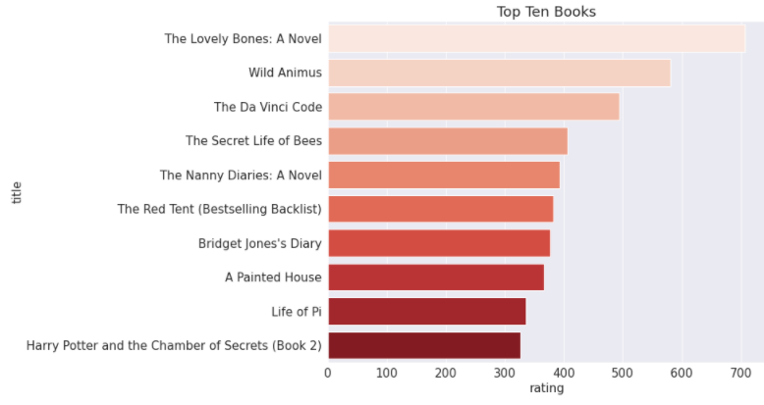
Predictions
Popularity Based Recommendation(Base Model)

Slide 21
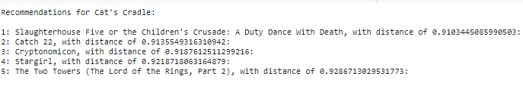
2. Collaborative Filtering Using KNN ( k-Nearest Neighbors)
Best parameters:
{algorithm='brute', leaf_size=30, metric='cosine', metric_params=None, n_jobs=None, n_neighbors=5, p=2, radius=1.0}
Recommendation for random book:

Slide 22
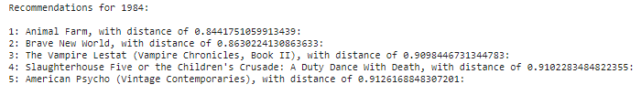
Contd..
Recommendation for known book from dataset:

Slide 23
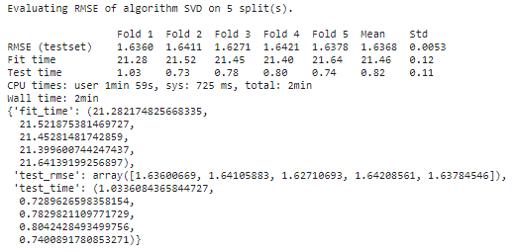
3. SVD(Singular Value Decomposition) Based recommendation System:
Performed Cross Validation on SVD by providing parameters as: (model, data, measures=['RMSE'], cv=5, verbose=True)

Slide 24
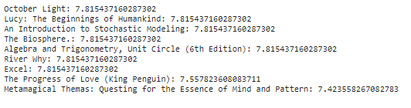
Contd..
Recommendation by giving user-id as input:
On picking a random user_id = 116866 our model recommend this books

Slide 25
Evaluation of models:
kNN (k-Nearest Neighbor) model gives the cosine distance value near to 1 for all book that are recommended.
In SVD on an average the Root Mean Square Error(RMSE) for our test data set prediction is near about 1.64 which is pretty good.

Slide 26

Challenges:
Understanding the metric for evaluation was a challenge as well.
Decision making on missing value imputations quite challenging.
Handling of sparsity was a major challenge.

Slide 27
Conclusion:
Recommendation system is unturned to exist in the e-commerce businesses with the help of collaborative or content-based filtering to predict different items and yes, users are most satisfied with the products recommended to them.
While performing Exploratory Data Analysis we observed that almost 42% of readers with age-34 read more books compared to other age group of readers.
Books with publication years are somewhat between 1950 - 2005.
Also the readers mostly give 8 ratings(on scale 1-10) to books followed by 10 and 7.
There are more readers from locations London, england, united kingdom, toronto, ontario, canada compare to other locations.
KNN model gives good recommendation for books.
The best collaborative book recommender model is SVD(Singular value decompostion) with best accuracy on test data which give stronger recommendations.
We can deploy this model.

Slide 28
Contributors Role
Saurabh Yadav:
Performed Data preprocessing and EDA (Exploratory Data Analysis)
Build Popularity Based Recommendation and SVD(Singular Value Decomposition) Based recommendation System model.
Shubham Deshmukh:
Performed Data preprocessing and EDA (Exploratory Data Analysis)
Build Collaborative Filtering Using KNN ( k-Nearest Neighbors) model.

Slide 29
Thank You Q & A

